Slide 1
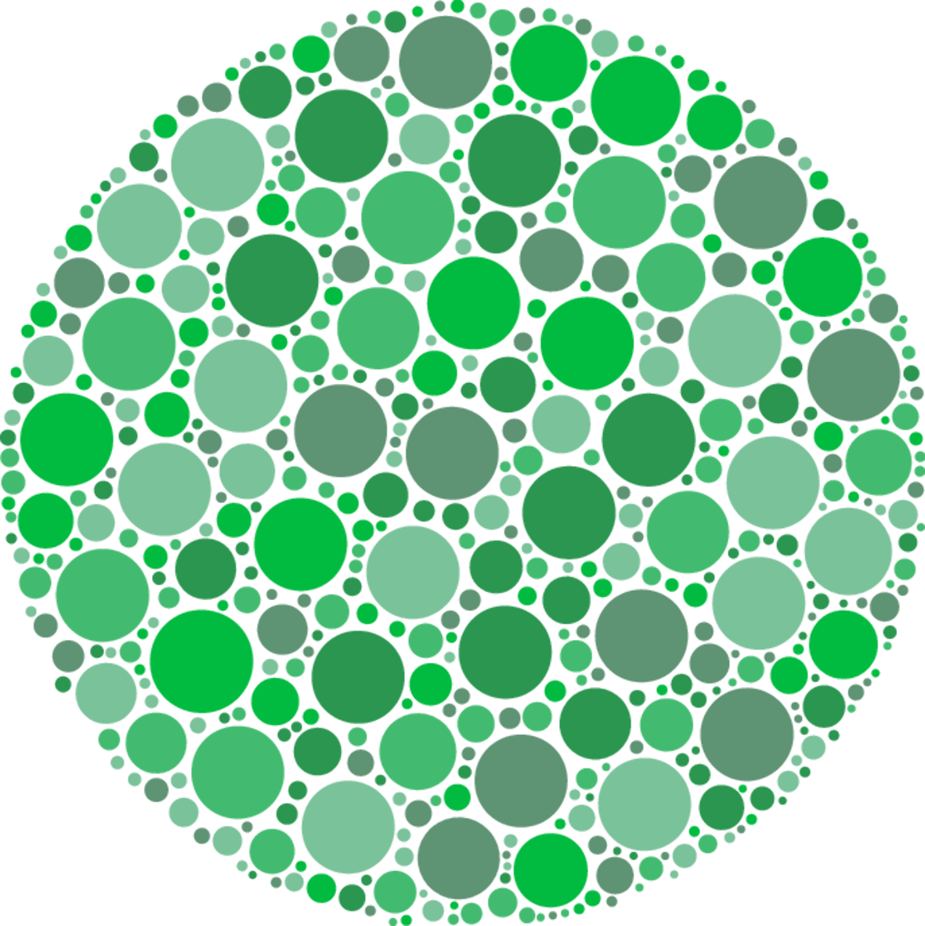
Intro to clustering,
Distance Metrics, and K-Means
Gert De Geyter – Machine learning guild bootcamp - March 2020

Slide 2

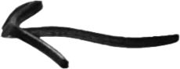
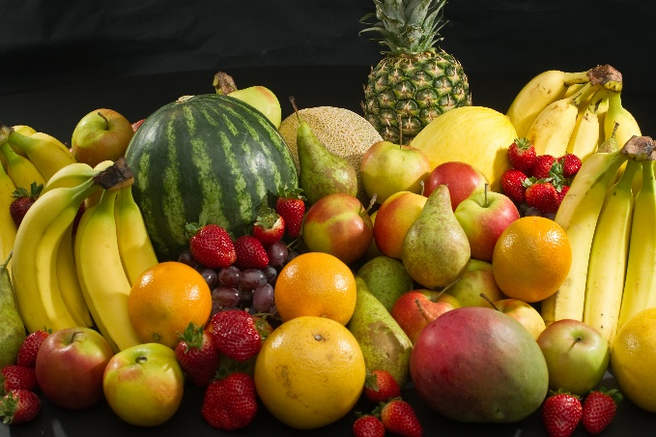
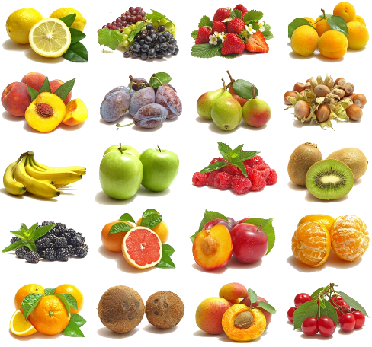

Supervised
Machine learning
“Labeled”
Good vs bad
Colors
Unsupervised
Learning
Unlabeled
Create own labels
Reinforcement
Instant feedback
Labels but only when asked
Parent – child style

Slide 3
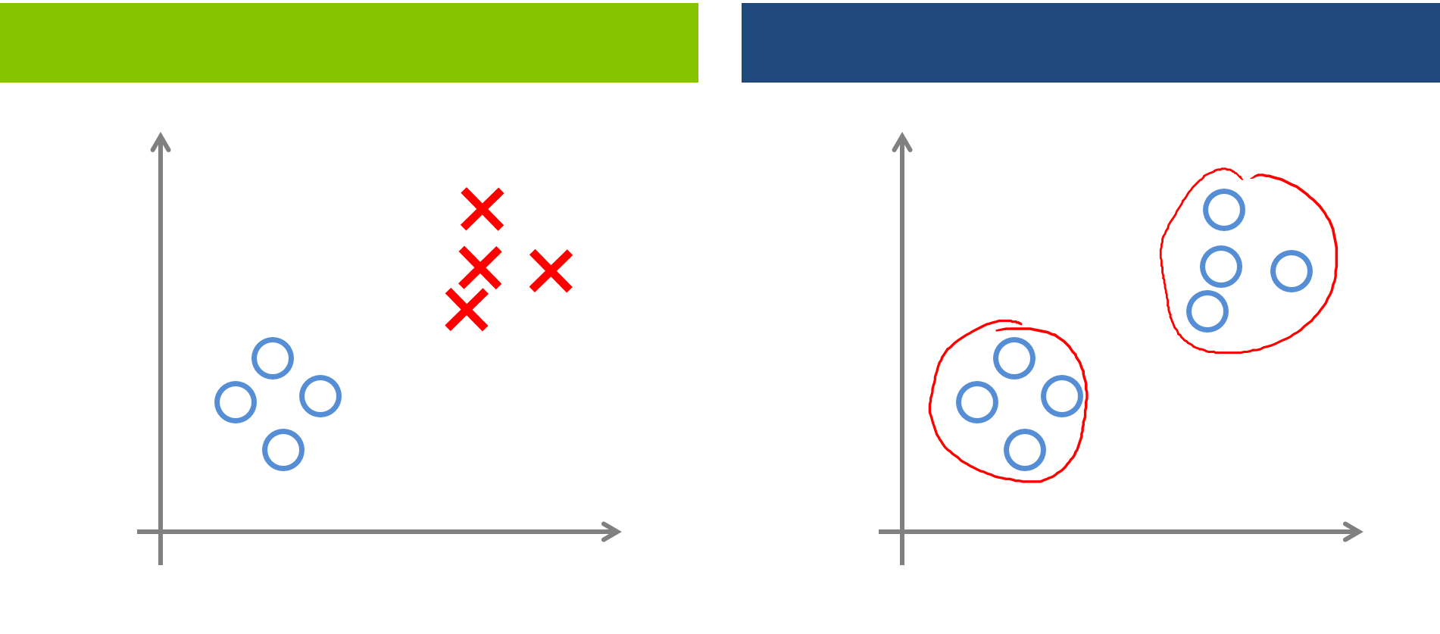
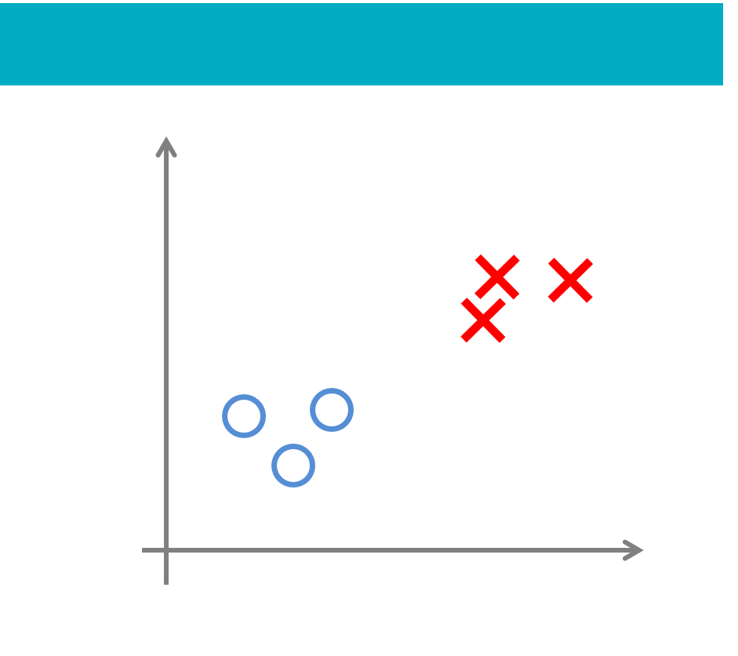
Machine learning
Artificial intelligence : any technique that mimics intelligence (weak A.I.) Machine learning : ability to learn without being explicitly programmed
Requires data to learn from!
Three main categories in machine learning
Thousands of algorithms and methods to solve a range of problems
Supervised
Unsupervised
Reinforcement

Slide 4
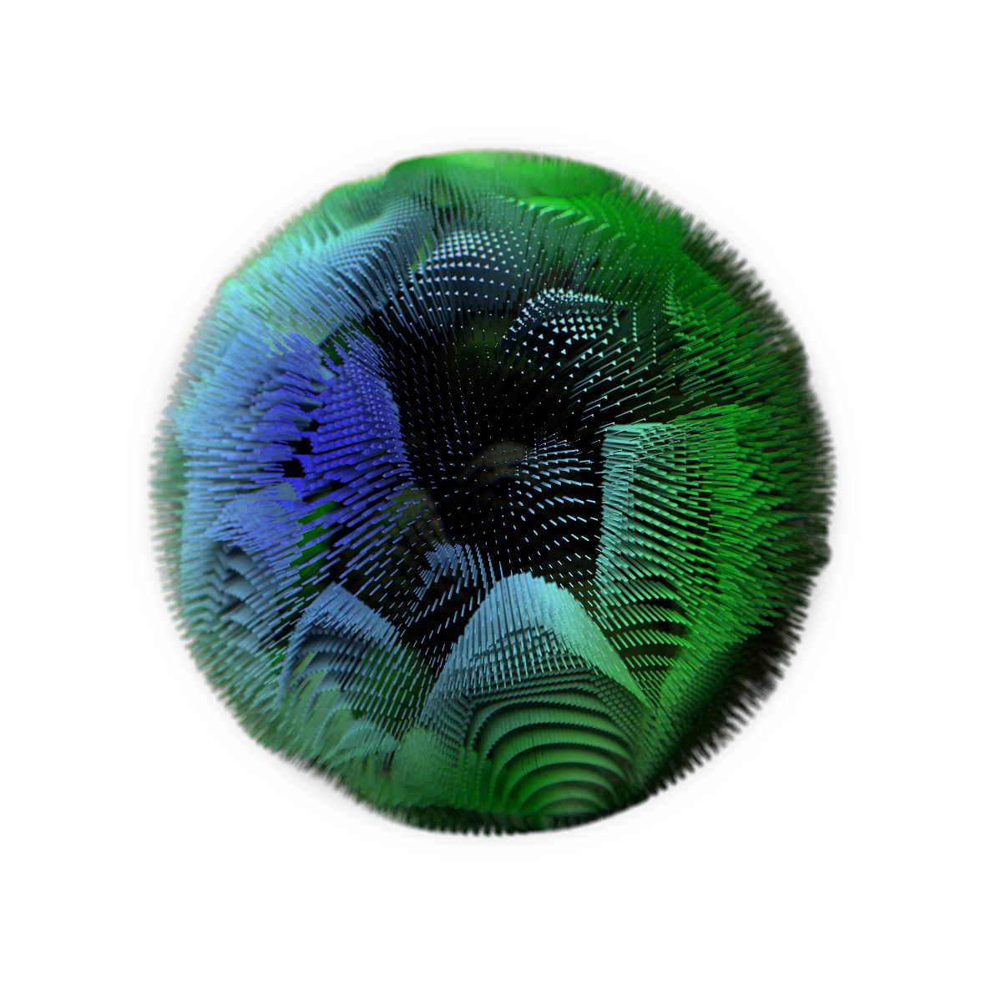
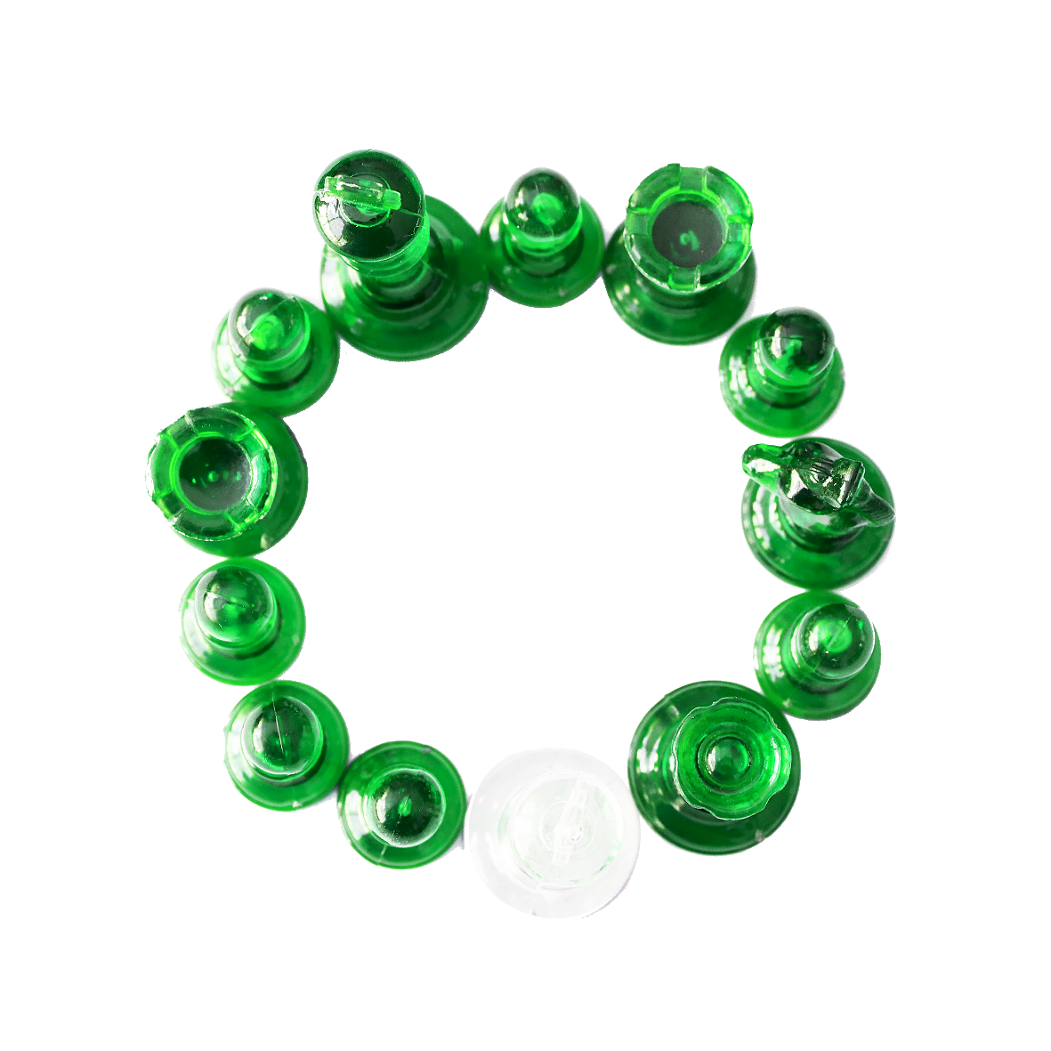
Unsupervised learning
Detecting patterns and relations in data without labels (either because there are none or they exist, but we don’t have them)
Clustering
Dimensionality reduction
Anomaly detection

Slide 5
Clustering
Algorithms that locate groups of related data points (“clusters”) with the ultimate goal to gain more insight in the data. This can be used to further label data, detect anomalies, segment data, reduce the dataset, etc. Several metrics to cluster data exist. The main ones (but not limited to):
Connectivity: create a cluster based on the distance and connectivity
Centroid: create a cluster based on the central weighted points of datapoints
Density: create clusters on how densely populated a part of the space is
Distribution: use a mathematical distribution model to find clusters
Topological: use topological features of the dataset to create a subspace. For example self-organizing maps using neural networks.
K-means is a centroid based clustering algorithm and is usually one of the first algorithms taught in any ML course.

Slide 6
Distance Metrics
A distance metric is a function that defines how the distance between a pair of points is calculated.
In machine learning, distance is the objective measure of the difference between data points. A number of machine learning algorithms rely in a distance metric to discover patterns in the input data, and a good distance metric helps to improve the model performance (e.g. K-Means and KNN).
The choice of distance metric is made based on the nature of the data itself, and not the model being used.
Euclidean
Manhattan
Chebychev
B
B
B
A
A
A

Slide 7

Euclidean Distance
The Euclidean distance represents the shortest “straight line” distance between two points and is the standard “physical” distance people usually think of. This is also referred to as the L2 distance and is computed using the Pythagorean Theorem, shown below:
$$d= \sqrt{\sum_{k}{{\left(x_{ik}−y_{jk}\right)}^{2}}}$$
B
The Euclidean metric is used when computing the distance between continuous numerical variables and the distances are equivalent across features.
Euclidean
A

Slide 8

Manhattan Distance
The Manhattan distance computes the difference between two points as the sum of the absolute differences across each dimension. This is also commonly referred to as the “city block”, “taxicab”, or L1 distance, and is computed as shown below.
$d= \left|\sum_{k}{x_{ik}−y_{jk}}\right|$
B
The Manhattan metric is used when computing the distance between discrete numerical variables where travel between one dimension and another has no meaning (i.e. when walking through a city, you cannot walk through walls and thus must walk around the full block)
A
Manhattan

Slide 9

Chebychev Distance
The Chebychev distance only considers the maximum difference along any single dimension when computing the distance between two points. This is also referred to as the “maximum difference”, “chessboard”, or L∞ distance, and is computed as follows:
$$d=max\left|x_{ik}−y_{jk}\right|$$
B
The Chebychev metric is used when movement along each dimension occurs at equal speed, independent of the other dimensions. (e.g. An overhead warehouse crane moving with two independent motors)
Chebychev
A

Slide 10
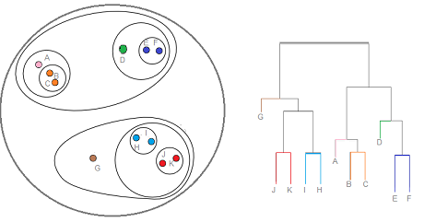
Linkage Distances
In addition to defining how we measure the distance between data points, we must also define how the distances between whole clusters are computed. But rather than comparing the similarity/difference between individual points, the linkage distance is established to compute the similarity/difference of whole populations.
Linkage distance is most important in hierarchical clustering techniques, where larger clusters are built up through the successive combination of smaller groups. In this process, the smaller groups with the largest similarity (smallest linkage distance) are combined first.

Slide 11



Single Linkage
The single linkage distance is computed as the shortest distance between any two points in the separate clusters.
$$L\left(R,S\right)=min\left(D_{ij}\right), i∈R, j∈S$$
Where $D_{ij}$ represents the distance between point i in cluster R, and point j in cluster S.
$$R$$
$$S$$
Single linkage distance is used when you want to maximize the distances between distinct clusters. However, in Agglomerative Clustering, single linkage can sometimes produce long or spread out clusters that should otherwise have been subdivided.

Slide 12

Complete Linkage
The complete linkage distance is computed as the greatest distance between any two points in the separate clusters.
$$L\left(R,S\right)=max\left(D_{ij}\right), i∈R, j∈S$$
Where $D_{ij}$ represents the distance between point i in cluster R, and point j in cluster S.
$$R$$
$$S$$
Complete linkage distance tends to produce more compact clusters than single linkage, but also ends with clusters that are closer together.

Slide 13

Average Linkage
The average linkage distance is computed as the arithmetic mean of all distances between points in the separate clusters.
$$L\left(R,S\right)=\frac{1}{n_{R}∗n_{S}}\sum_{i=1}^{n_{R}}{\sum_{j=1}^{n_{S}}{D(i,j)}}, i∈R, j∈S$$
Where $D_{ij}$ represents the distance between point i in cluster R, and point j in cluster S, and $n_{R}$ and $n_{S}$ are the count of points in clusters R and S respectively.
$$R$$
$$S$$
Average linkage distance is one of the most commonly used cluster distances that produces robust results with well spaced clusters comprised of tightly grouped members.

Slide 14

Centroid Linkage
The centroid linkage distance is computed as the distance between the centroids of the two clusters.
$$L\left(R,S\right)=\left\|c_{R}−c_{S}\right\|$$
Where $c_{R}$ and $c_{S}$represent the centroid positions of clusters R and S respectively
$$R$$
$$S$$
Cluster centroids are prone to moving when new data points are included, making the centroid linkage distance the most unstable, especially in centroid based clustering algorithms.

Slide 15




K-means
We start from the assumption of a center number of clusters $k$ (see more later)
Y
Determine centroid location: $μ_{1},μ_{2}, …,μ_{k}$
2. Calculate the boundaries: Draw a line between centroid and place a ”plane” orthogonal to it halfway between both. Do this for all centroids and determine the segmentation of each cluster
$$c^{(i)}= {\arg{\min_{j}\left\|x^{(i)}− μ_{j}\right\| }}^{2}$$
3. Determine the new center of mass $μ$ for each cell.
4. Move your centroid to the new point
5. Repeat step 2 to 4 a fixed number of times or until you reach convergence.
X

Slide 16
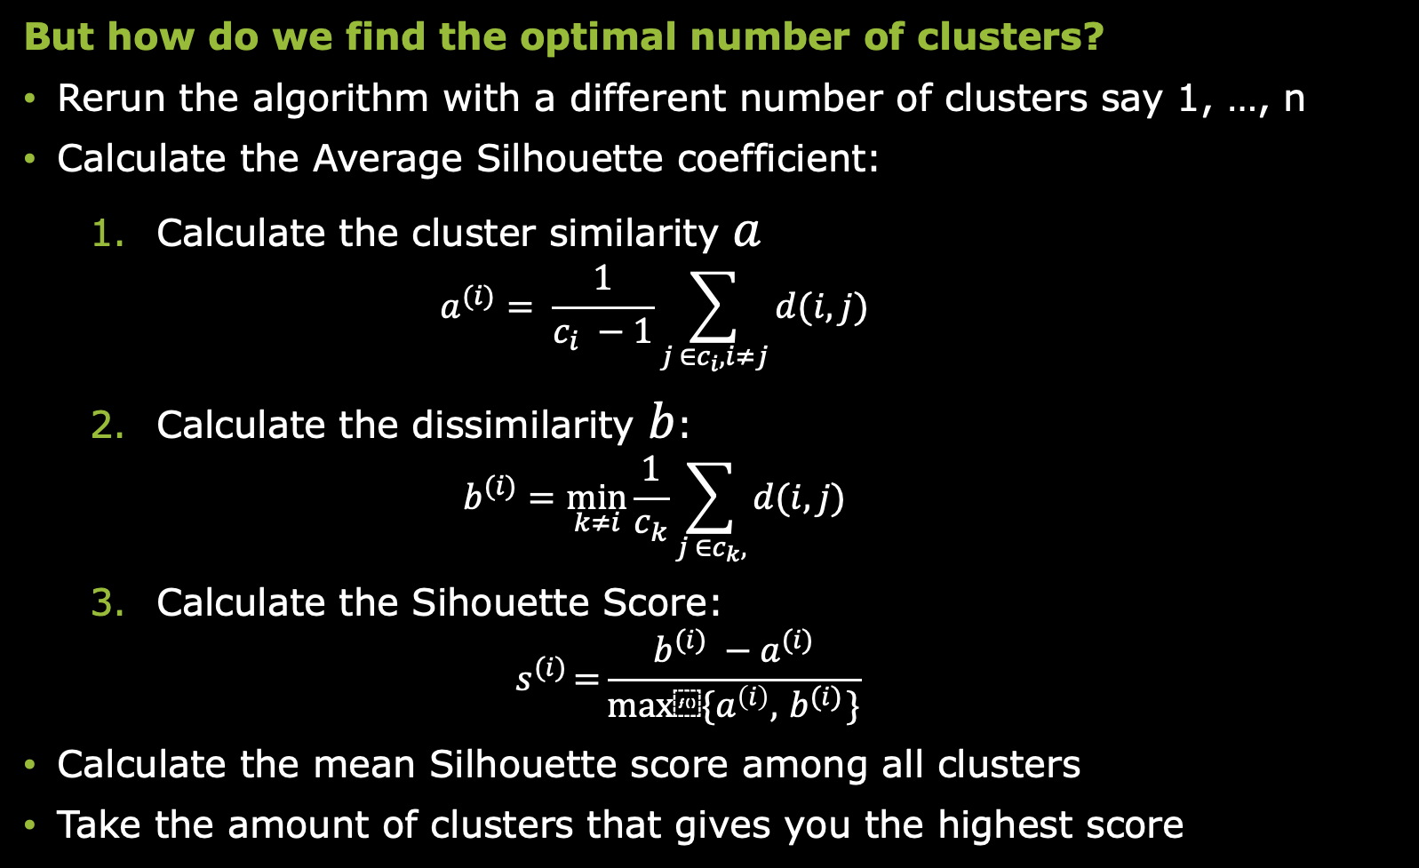
K-means – average Silhouette coefficient
But how do we find the optimal number of clusters?
Rerun the algorithm with a different number of clusters say 1, …, n
Calculate the Average Silhouette coefficient:
Calculate the cluster similarity $a$ $a^{(i)}= \frac{1}{c_{i} −1}\sum_{j ∈c_{i}, i≠j}{d(i,j)}$
Calculate the dissimilarity $b$: $b^{(i)}=\min_{k≠i}{\frac{1}{c_{k}}\sum_{j ∈c_{k},}{d(i,j)}}$
Calculate the Sihouette Score: $s^{(i)}={\frac{b^{(i)} −a^{(i)}}{max⁡\{a^{\left(i\right)}, { b}^{(i)}\}}}$
Calculate the mean Silhouette score among all clusters
Take the amount of clusters that gives you the highest score
Expresses how far a point is from other points within the same cluster
Expresses how far a point is from other points within the closest neighboring cluster
Expresses how well a clusters describes its own points versus the closest neighbor

Slide 17


K-means
In this use case we will apply scikit-learn on a dataset describing flower petals
We will use K-means to determine the optimal split between these physical features
K-means finds the most distinct clusters within data set by iteratively reassign new centers
(In this case we assume the optimal number is three, in reality there are ways to determine the optimal number)
This is unsupervised as we don’t give the algorithm any specific labels. Instead we let it define it’s own rules to create three most distinct clusters in the dataset

Slide 18
K-means
import numpy as np import matplotlib.pyplot as plt from mpl_toolkits.mplot3d import Axes3D from sklearn.cluster import KMeans from sklearn import datasets np.random.seed(5) iris = datasets.load_iris() X = iris.data y = iris.target name = 'k_means_iris_3' est= KMeans(n_clusters=3) fignum = 1 titles = ['3 clusters'] fig = plt.figure(fignum, figsize=(4, 3)) ax = Axes3D(fig, rect=[0, 0, .95, 1], elev=48, azim=134) est.fit(X) labels = est.labels_ ax.scatter(X[:, 3], X[:, 0], X[:, 2], c=labels.astype(np.float), edgecolor='k') ax.w_xaxis.set_ticklabels([]) ax.w_yaxis.set_ticklabels([]) ax.w_zaxis.set_ticklabels([]) ax.set_xlabel('Petal width') ax.set_ylabel('Sepal length') ax.set_zlabel('Petal length') ax.set_title(titles[fignum - 1]) ax.dist = 12 fignum = fignum + 1
Notice that we import the necessary packages again
The data is already present in the library itself
We assign three clusters
We plot the clusters in 3D (this requires to execute the code in console by selecting it >right click > execute in console)
This time we don’t split the data as we don’t have any labels

Slide 19
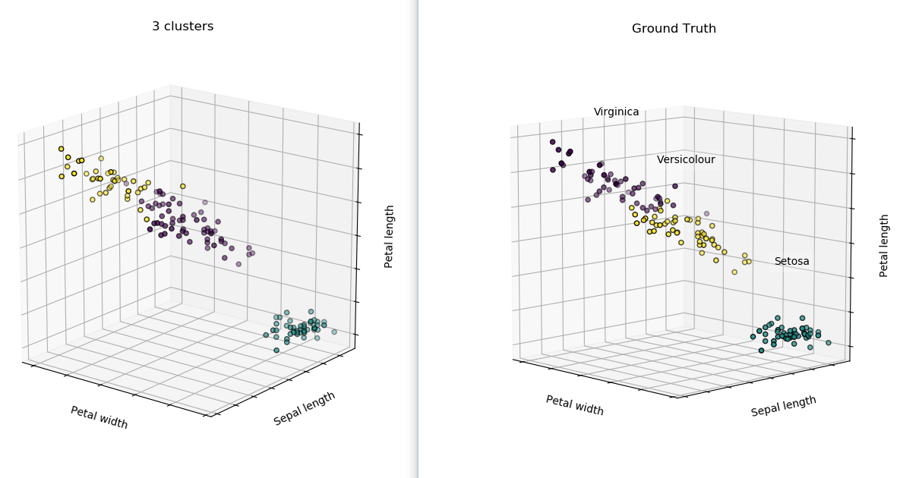
K-means
# Plot the ground truth fig = plt.figure(fignum, figsize=(4, 3)) ax = Axes3D(fig, rect=[0, 0, .95, 1], elev=48, azim=134) for name, label in [('Setosa', 0), ('Versicolour', 1), ('Virginica', 2)]: ax.text3D(X[y == label, 3].mean(), X[y == label, 0].mean(), X[y == label, 2].mean() + 2, name, horizontalalignment='center', bbox=dict(alpha=.2, edgecolor='w', facecolor='w')) # Reorder the labels to have colors matching the cluster results y = np.choose(y, [1, 2, 0]).astype(np.float) ax.scatter(X[:, 3], X[:, 0], X[:, 2], c=y, edgecolor='k') ax.w_xaxis.set_ticklabels([]) ax.w_yaxis.set_ticklabels([]) ax.w_zaxis.set_ticklabels([]) ax.set_xlabel('Petal width') ax.set_ylabel('Sepal length') ax.set_zlabel('Petal length') ax.set_title('Ground Truth') ax.dist = 12 fig.show()
However, in fact we have something similar
The iris flowers belong to specific families
If we overplot these we see the clusters overlay nicely with the actual families

